Slide 1

OCCUPANCY SENSING
An occupancy-estimation pipeline for the Workroom pilot study
Notes:
The occupant count at a given timestep was defined as the sum of PIR sensors detecting presence in the space. Thus, the occupant count was the number of desks that were used in a given timestep. The diversity factor at a given timestep was defined as the ratio between the number of PIR sensors detecting presence (or the occupant count) compared to the total number of PIR sensors in the space. Thus, the diversity factor expressed the ratio of how many desks were used in a given timestep.

Slide 2
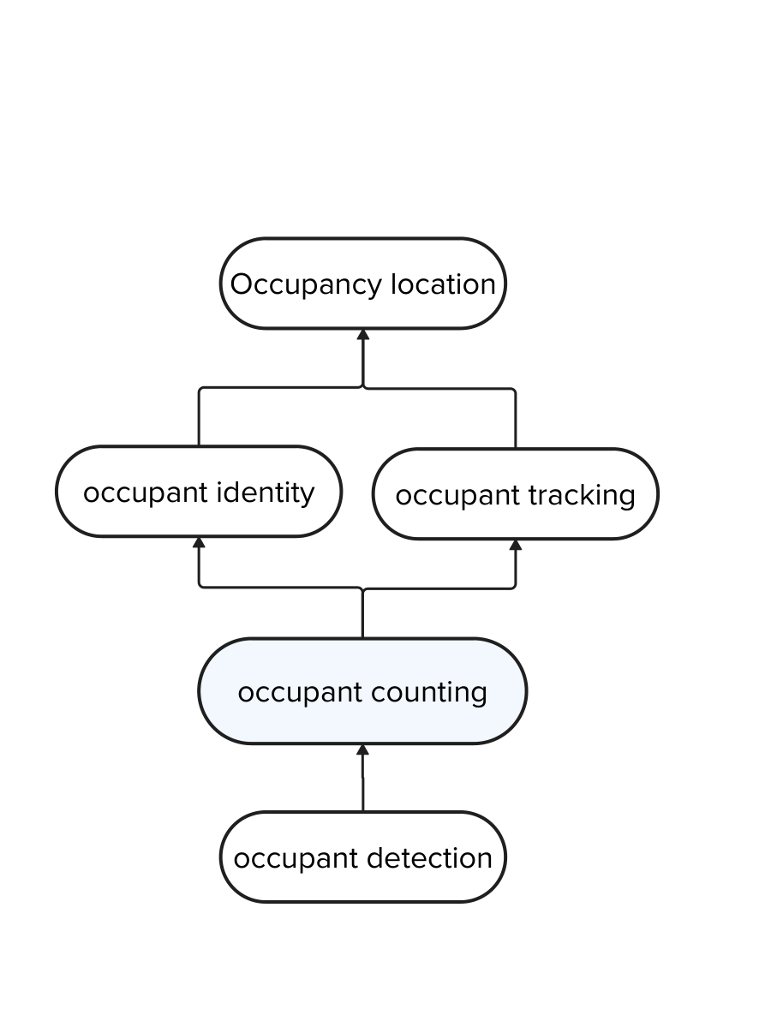
OCCUPANCY SENSING
STUDY OBJECTIVES
Attempt to fill a gap where a need is reported for more research on sensing methods that are able to provide reliable presence detection and occupant count in multi-occupancy spaces such as open-plan offices (Naylor et al. 2018).
Demonstrate which and how the collected data could be used by e.g. building designers or operating managers
Generate occupancy schedule for input in building simulation models
Evaluate the design ventilation airflow for HVAC sizing
Evaluate decisions regarding change of office space layout
In a nutshell, guide future research on occupancy prediction using machine learning for better building design, operation, and understanding of occupant behavior
Chitnis, S., Somu, N., & Kowli, A. (2025b). Occupancy estimation with environmental sensors: The possibilities and limitations. Energy and Built Environment, 6(1), 96–108. https://doi.org/10.1016/j.enbenv.2023.09.003
Notes:
The occupant count at a given timestep was defined as the sum of PIR sensors detecting presence in the space. Thus, the occupant count was the number of desks that were used in a given timestep. The diversity factor at a given timestep was defined as the ratio between the number of PIR sensors detecting presence (or the occupant count) compared to the total number of PIR sensors in the space. Thus, the diversity factor expressed the ratio of how many desks were used in a given timestep.

Slide 3
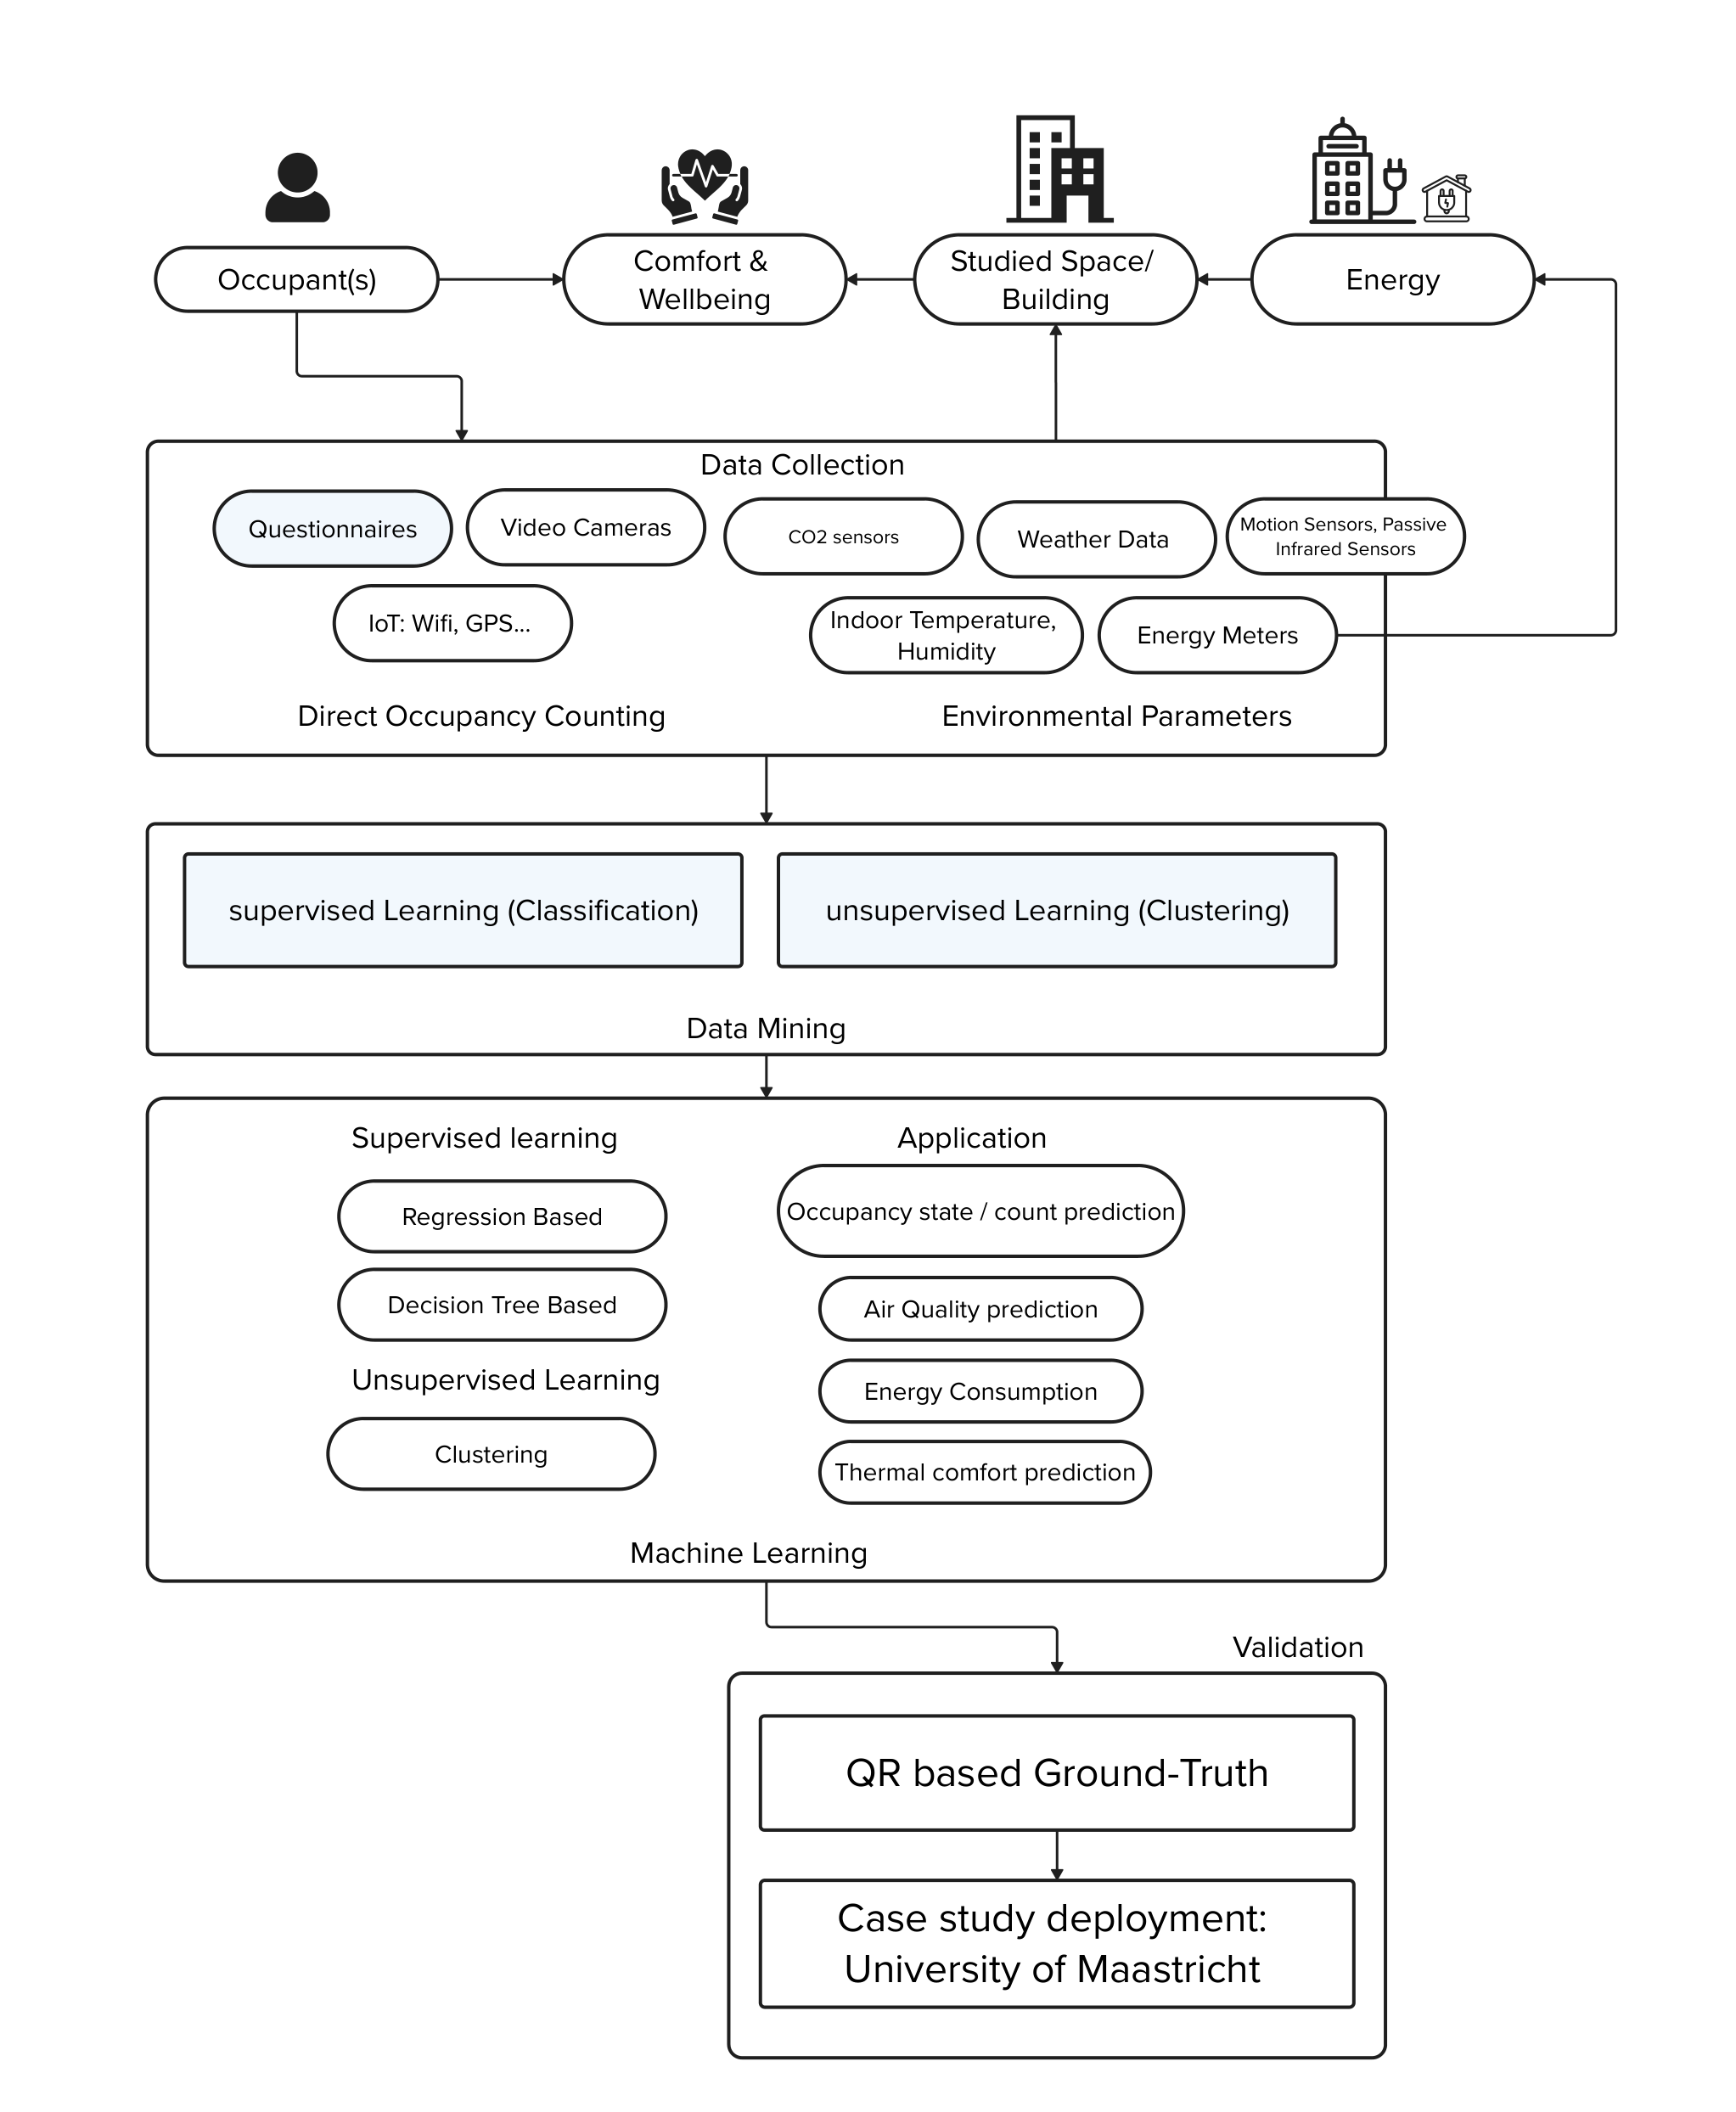
0. PILOT STUDY PLANNING
Build a decision-making pipeline, a smart context-aware occupancy estimation toolkit. test and refine a flexible framework for occupancy estimation using sensor fusion data, typology metadata, space-specific logic, to choose the right modelling strategy for that context. Methodology-as-a-service.
SENSOR SELECTION CRITERIA
Non-invasive
LoRaWAN or low-power wireless communication
Calibration and reliability
Deployment practicality
Compact: plug and play
PIR + Env. parameters
Sheikh Khan, D., Kolarik, J., Anker Hviid, C., & Weitzmann, P. (2021). Method for long-term mapping of occupancy patterns in open-plan and single office spaces by using passive-infrared (PIR) sensors mounted below desks. Energy and Buildings, 230, 110534. https://doi.org/10.1016/j.enbuild.2020.110534

Slide 4
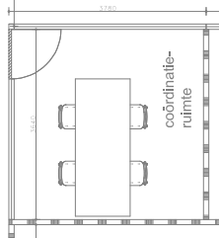
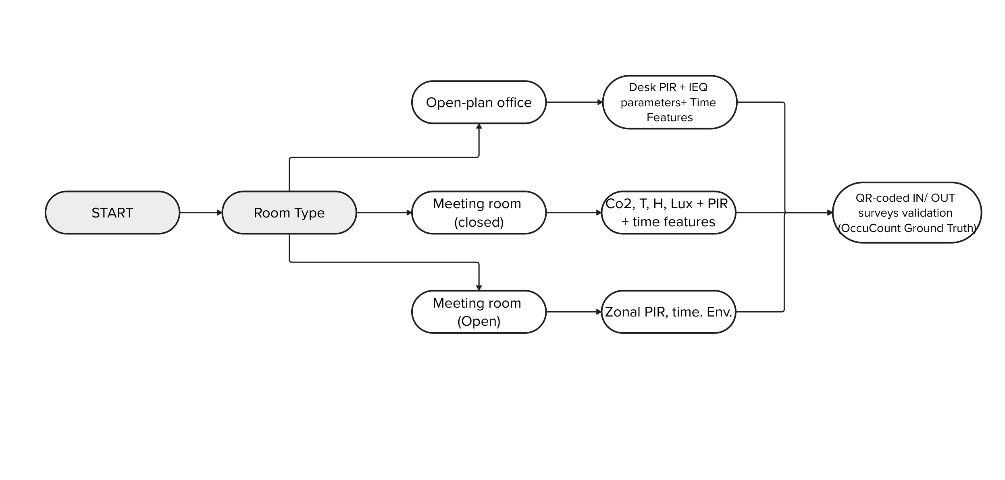
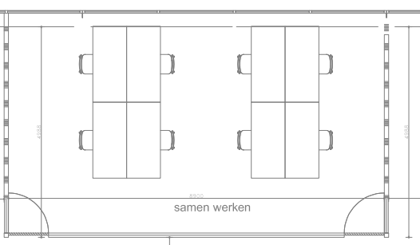
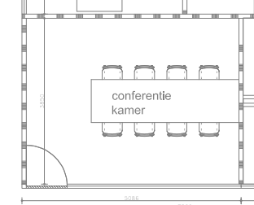
0. PILOT STUDY PLANNING
A pilol study was carried out to understand the best placement for each sensor across different types of spaces such as the following:
CELSIUS
WORKROOM
PROPOSED ROOMS
/ TYPOLOGIES
ROOMS
Room Name | Typology | Volume | Function | Expected Use Pattern
Celsius | Tiny meeting | Small | 1–4 people, short meetings | Irregular
Tesla | Circular meeting | Medium | Group sessions | Ad hoc
Workroom | Open-plan office | Small/med | 3–4 occupants working | Stable
TESLA
Sheikh Khan, D., Kolarik, J., Anker Hviid, C., & Weitzmann, P. (2021). Method for long-term mapping of occupancy patterns in open-plan and single office spaces by using passive-infrared (PIR) sensors mounted below desks. Energy and Buildings, 230, 110534. https://doi.org/10.1016/j.enbuild.2020.110534

Slide 5
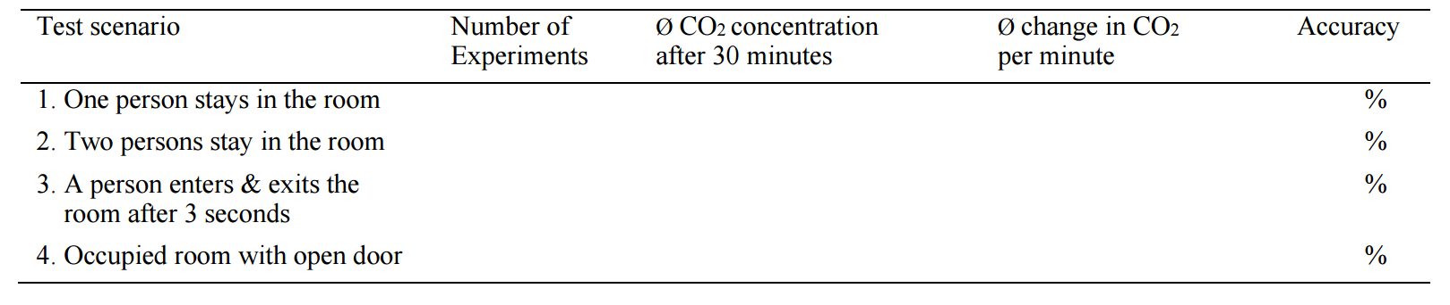
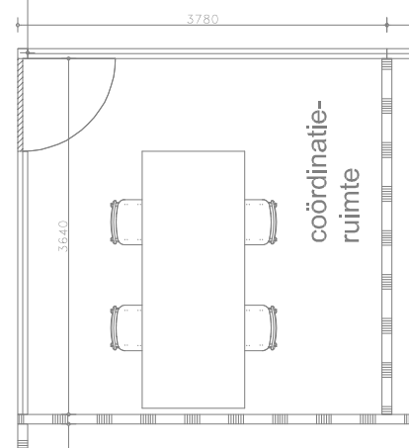
1. PILOT STUDY: understanding the sensor
The pilot tests included several test scenarios to understand limitations of each logged parameter such as PIR and CO2 etc. as well as validate the range covered by the sensor for each parameter as stated on the tech sheet. Such as:
Test Scenario | Configuration | Purpose
1A One person sits at A (30 min) | Only seat A | Establish baseline CO₂ rate from one occupant
1B Repeat at seats B, C, and D | One seat at a time | Identify seat-specific PIR + CO₂ response
2A Two people at A + C (30 min) | Diagonal pair | Test interaction of multiple sources + balance
2B Two people at A + B or B + D | Same side or L-shape | See if placement symmetry affects CO₂ dispersion
3 Person enters, sits 3 seconds, exits | One seat, random or A | Test PIR + CO₂ sensitivity to brief entry
4 Room occupied (2–3 persons) + door open | Natural activity | Assess ventilation effect on sensor response
5 Full occupancy (4 persons, 30 min) | All seats | Max-load response + peak CO₂ reading accuracy
6 Vary durations (10, 20, 40 min) | Repeat with 1–4 occupants | Validate response speed and slope in ∆CO₂/min
Result:
Test Scenario | Seat(s) Used | # People | Time (min) | Avg CO₂ (ppm) | ∆CO₂/min | PIR Triggered? | Accuracy vs GT
1A | A | 1 | 30 |  |  | Y/N | %
2A | ... | ... | ... | ... | ... | Y/N | %

Slide 6
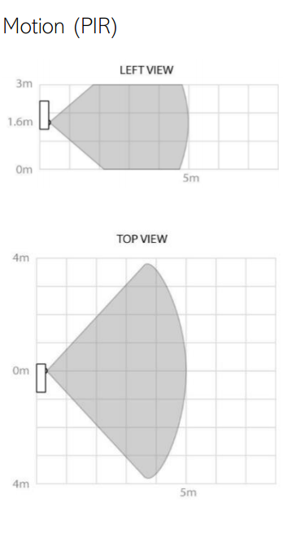
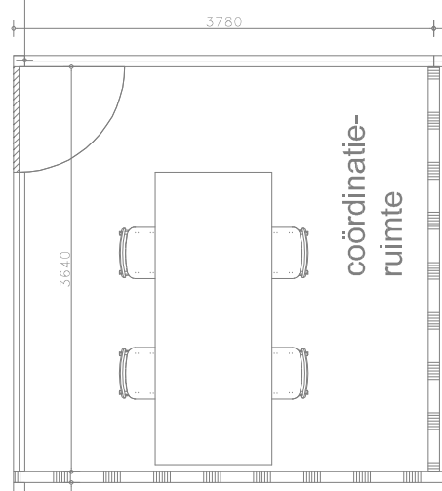
2. PILOT TESTING IEQ occupancy vs. ground truth testing
The pilot tests included several test scenarios to understand limitations of each logged parameter such as PIR and CO2 etc. as well as validate the range covered by the sensor for each parameter as stated on the tech sheet. Such as:
Historical Data check
CO2
Validate which sensors work per space
Build feature extraction logic
Design a decision-tree for future deployment (based on room type, door state, etc.)
Train small models using ground truth data (QR surveys set up in rooms) to estimate headcount vs. truth
(Blazevic et al. 2024)
STEP 1
5 m detection
Sensi
At 1.6m height
There is no one-size-fits-all sensor solution for occupancy estimation. But there can be a generalizable framework that adapts to space type and data quality.
* Effective detection area: up to 7.5 m wide × 6.0 m deep under ideal conditions.
** After detecting motion, the PIR sensor goes into a 30-second "blanking" period. Not ideal for detecting still occupancy without some motion.

Slide 7

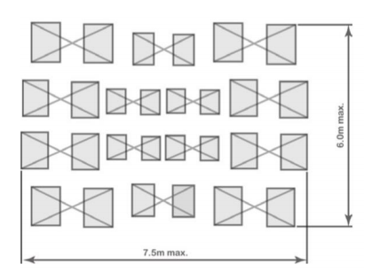
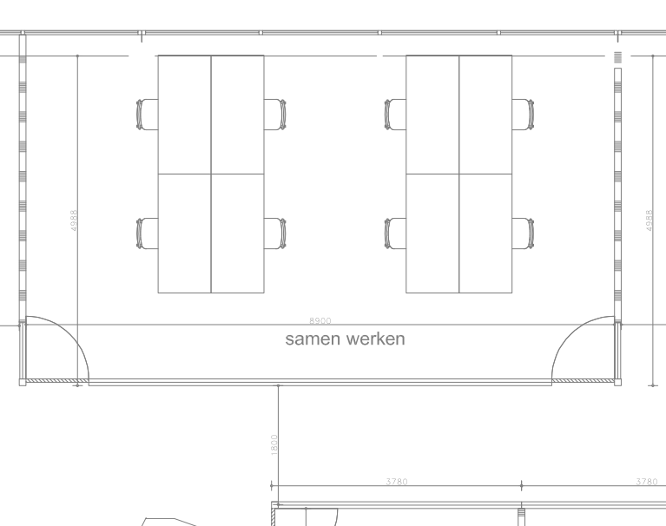
2. PILOT TESTING [Celsius]
Detection Pattern
Reliability of applying desk-mounted PIR sensors based on the mean ∆OC
The mean of the accuracy for all days pr. Sensor will be used to determine the overall mean and confidence interval for the sensors, where:
OC_{PIR} is the occupant count based on PIR
OC_{GT} is the occupant count based on Ground Truth GT
Sample size (n) for accuracy is number of desks/ seats and for occupancy count (OC) is number of days.
PIR sensor
Sensi
PIR Sensing alone vs. CO₂ vs. Sensor Fusion (+ML)

Slide 8
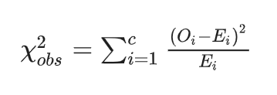

2. PILOT TESTING [Celsius]
The pilot tests included several test scenarios to understand limitations of each logged parameter such as PIR and CO2 etc. as well as validate the range covered by the sensor for each parameter as stated on the tech sheet. Such as:
PIR
STAGE 2
(Sheikh khan et al. 2021)
Chi-Square Test (χ²) to validate PIR-sensor based occupancy detection against a known truth:
5 m detection
Test of goodness: observed presence/ absence using PIR vs. GT.
Where:
O_{i} is the observed frequency (number of presence or absence in PIR)
E_{i} is the expected frequency (number of presence or absence in GT) of the _{i}th PIR sensor.
C count of sensors observed
Sensi
1.6m height
Sensor’s ability to accurately detect presence.
Accuracy estimates the number of times a sensor correctly identified presence and absence and was calculated for each PIR sensor pr. day. Where:
TP, number of true positive
TN, number of true negative
FP, number of false positive
FN, number of false negative
* Effective detection area: up to 7.5 m wide × 6.0 m deep under ideal conditions.
** After detecting motion, the PIR sensor goes into a 30-second "blanking" period. Not ideal for detecting still occupancy without some motion.

Slide 9
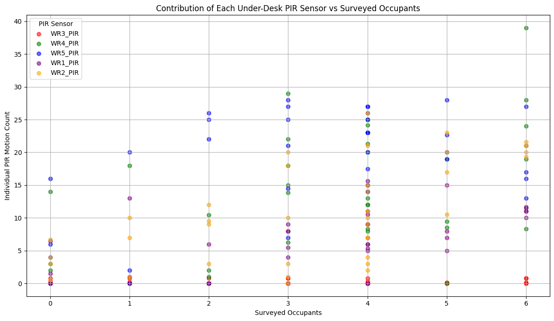
2. PILOT TESTING [Workroom]
INDIVIDUAL PIR vs.
GROUND TRUTH
1
5
IEQ1
1
IEQ2
2
3
4
IEQ3
All PIR BELOW
Considerations:
PIR ≠ seated presence: PIR sensors detect motion, not static presence. If someone sits still for a long time, it may underreport. If someone fidgets, it overreports.
The summed PIR count is reliable for estimating total occupancy.
But for seat-level or sensor-level analysis, contributions vary substantially.
PIR sensor
Sensi
SENSOR GRID APPROACH
Can we tell presence by day from this? Like attendance?

Slide 10
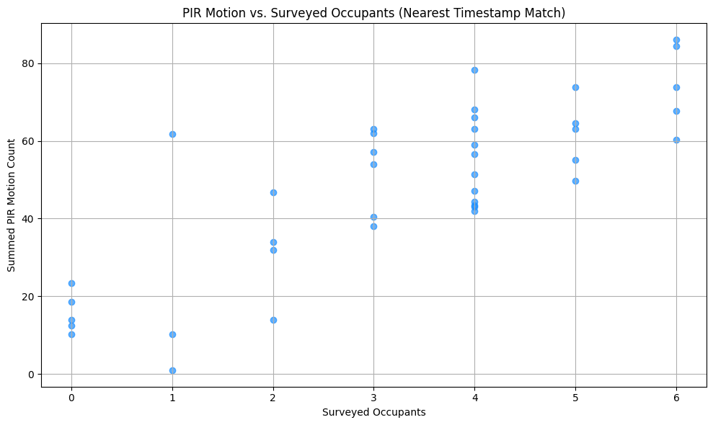
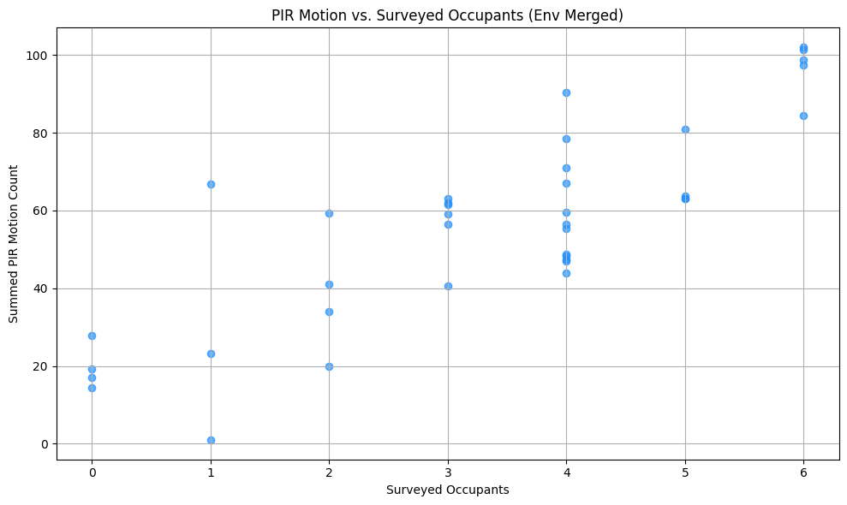
2. PILOT TESTING [Workroom]
PIR Data = Count i.e. Sensor counts motions events between two transmissions
Aggregate PIR vs.
GROUND TRUTH
PIR detects motion — not presence.
It tells us that on average, more people tend to generate more motion — but not always. It's an indirect proxy for occupancy, not a ground truth.
All PIR summed below and top (+Env)
📈 Pearson correlation: 0.837 (p=1.77e-11)
📈 Spearman correlation: 0.803 (p=4.54e-10)
Considerations:
PIR ≠ seated presence: PIR sensors detect motion, not static presence. If someone sits still for a long time, it may underreport.
Under-desk placement is good if there’s enough leg movement or occasional motion while seated.
Activity bias: A single active person may trigger as much motion as two quieter ones.
All PIR BELOW
Notes:
PIR sensors strongly reflect actual occupancy, even though people report their numbers manually and PIR counts vary due to activity level.
Your survey timestamps are aligned accurately enough to capture representative motion for those periods.
The data quality and timestamp alignment (especially with nearest-time matching) are validated by this strong correlation.
This supports using PIR motion counts as a proxy or estimator for real occupancy, especially in absence of manual surveys.
How the PIR sensor works:
Detects motion using a passive IR senso
There is a blanking time of 30 seconds of the PIR triggering after each PIR trig and after each transmission. This is to reduce the risk of self-triggering from internal events that could disturb the high sensitivity PIR circuits.
In other words:
This is a hardware-level delay.
After detecting motion, the PIR sensor intentionally disables itself (or suppresses reporting) for about 30 seconds to:
Avoid rapid retriggering due to noise or vibration (e.g., fans, electronics).
Conserve power and bandwidth in LoRa/low-power devices.
Prevent "self-triggering" due to residual heat or internal interference.
→ This means the sensor will not register new motion until the blanking period ends.
Angle / in report.

Slide 11
2. PILOT TESTING [Workroom]
Test Scenario | Configuration | Purpose
10, 20, 30 mins | Entry and exit for each | Simulate intermittent occupancy, PIR and co2 decay and build
1A One person sits at A (2 seconds, 2 mins, 5, 10, 20, 30 min) | Only seat A | Establish baseline CO₂ rate from one occupant
1B Repeat at seats B, C, and D (5, 10, 20, 30) | One seat at a time | Identify seat-specific PIR + CO₂ response
2A Two people at A + C (30 min) | Diagonal pair | Test interaction of multiple sources + balance
2B Two people at A + B or B + D | Same side or L-shape | See if placement symmetry affects CO₂ dispersion
3 Person enters, sits 3 seconds, exits | One seat, random or A | Test PIR + CO₂ sensitivity to brief entry
4 Room occupied (2–3 persons) + door open | Natural activity | Assess ventilation effect on sensor response
5 Full occupancy (4 persons, 30 min) | All seats | Max-load response + peak CO₂ reading accuracy
6 Vary durations (10, 20, 40 min) | Repeat with 1–4 occupants | Validate response speed and slope in ∆CO₂/min
A
C
B
D
16 July (10 mins)
Scenario | Seat(s) Used | # People | Time (min) | Avg CO₂ (ppm) | ∆CO₂/min | PIR Triggered? | Accuracy vs GT
1A | A | 1 | 30 |  |  | Y/N | %
... | ... | ... | ... | ... | ... | ... | ...

Slide 12
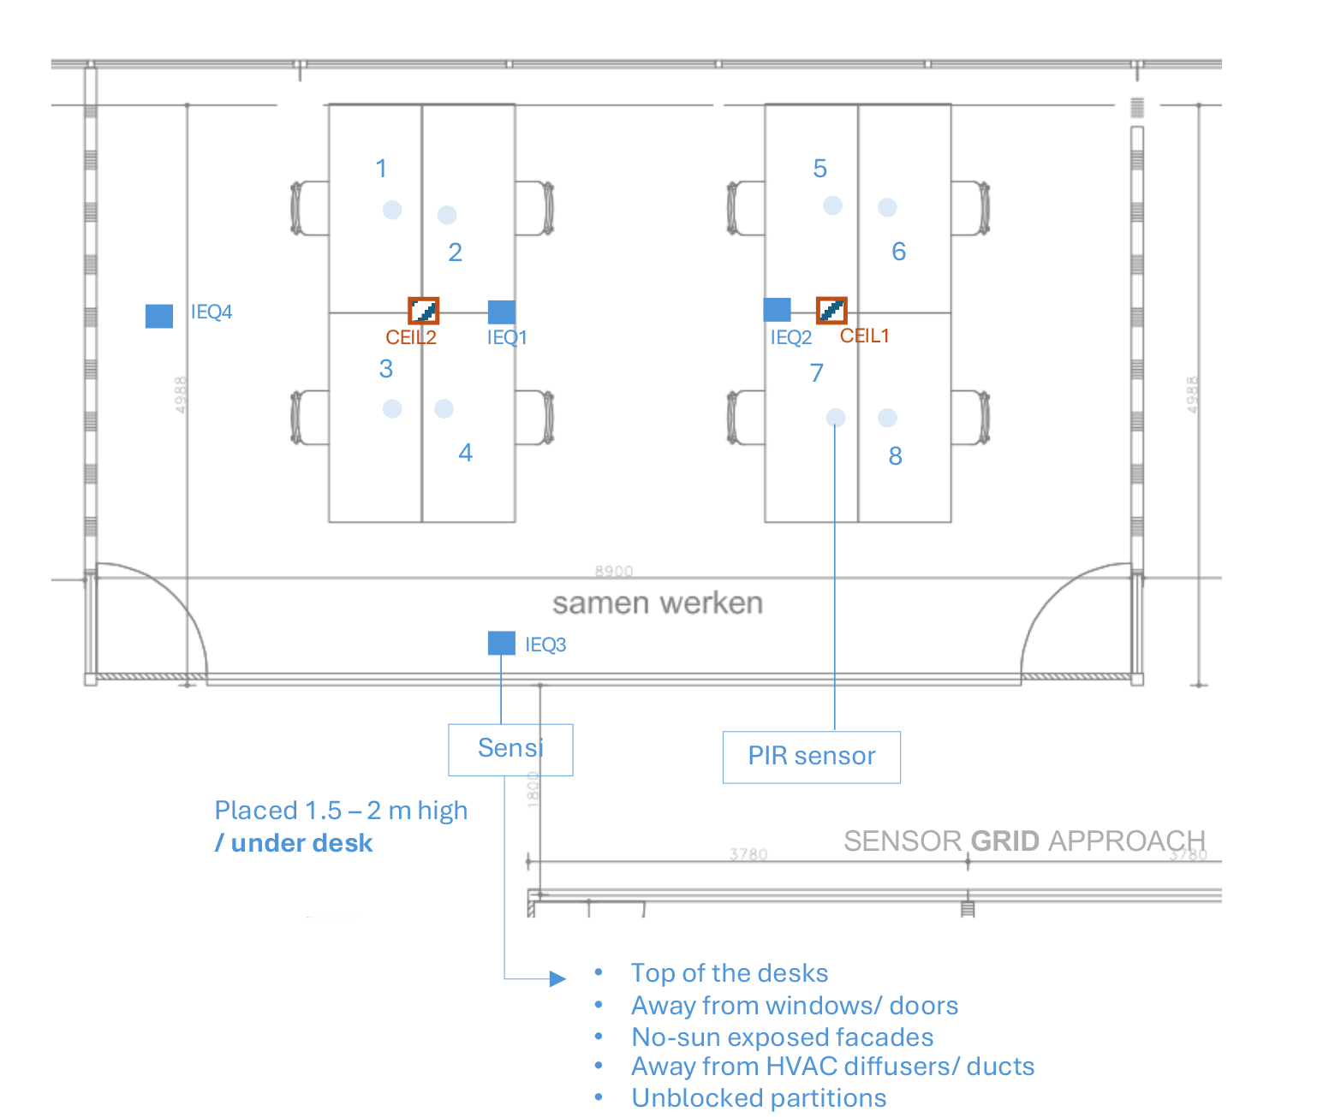
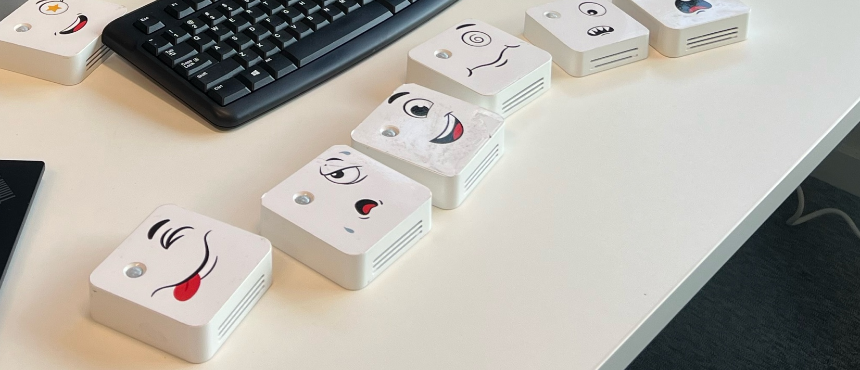
To replicate a sensor-fusion workflow for estimating room occupancy using environmental and desk-level sensor data collected in a real office environment, the workroom.
The goal is to process raw time-series data, align it with manually reported occupancy counts (below survey), engineer meaningful features, and train machine-learning models to predict how many people were present in the room.
3. CASE STUDY Workroom

Slide 13
3. CASE STUDY OBJECTIVES
Understand the dataset structure Identify the different data sources, including WR desk sensors, IEQ room sensors, and manual occupancy responses.
Clean and prepare irregular time-series data Detect timestamp issues, temporal gaps, missing values, and changes in data collection frequency.
Merge multiple sensor streams Align sensor data from different devices using timestamp-based merging or resampling.
Create occupancy ground-truth labels Match sensor readings with the closest valid manual occupancy response without using future information.
Engineer occupancy-relevant features Generate features from PIR, CO₂, lux, temperature, humidity, and time-of-day variables.
Train and compare machine-learning models Test different models such as Poisson regression, Random Forest, and HistGradientBoosting.
Evaluate model performance Use time-series cross-validation and report metrics such as MAE, RMSE, and Acc@±1.
Interpret the limitations of the results Discuss the effect of temporal gaps, irregular sampling, interpolation choices, timestamp alignment, and class imbalance.

Slide 14
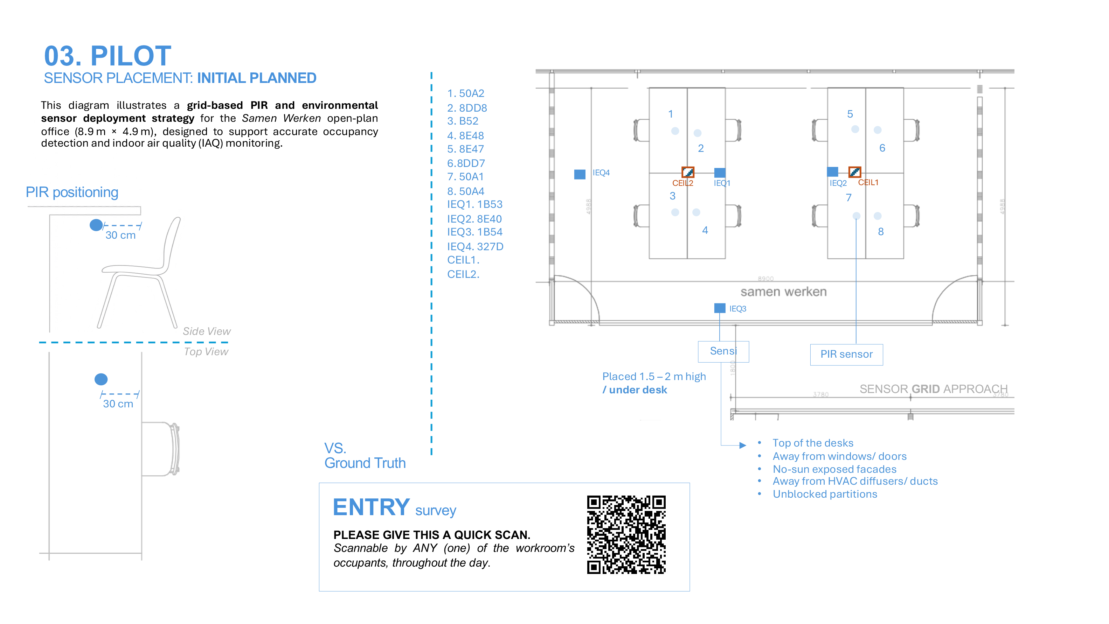


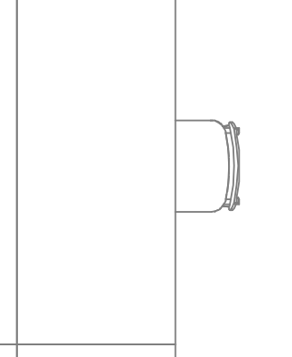

03. PILOT
SENSOR PLACEMENT: INITIAL PLANNED
3. CASE STUDY PLACEMENT [Workroom]
This diagram illustrates a grid-based PIR and environmental sensor deployment strategy for the Samen Werken open-plan office (8.9 m × 4.9 m), designed to support accurate occupancy detection and indoor air quality (IAQ) monitoring.
PIR positioning
30 cm
1B5A
1B5B
Side View
Top View
PIR sensor
Sensi
Placed 1.5 – 2 m high
SENSOR GRID APPROACH
30 cm
Data collection frequency/ Timestamp:
10 min. (up until 2025-10-08) and then switched to 1 min.
VS.
Ground Truth
Away from windows/ doors
No-sun exposed facades
Away from HVAC diffusers/ ducts
Unblocked partitions
ENTRY survey
PLEASE GIVE THIS A QUICK SCAN.
Scannable by ANY (one) of the workroom’s occupants, throughout the day.
Sheikh Khan, D., Kolarik, J., Anker Hviid, C., & Weitzmann, P. (2021). Method for long-term mapping of occupancy patterns in open-plan and single office spaces by using passive-infrared (PIR) sensors mounted below desks. Energy and Buildings, 230, 110534. https://doi.org/10.1016/j.enbuild.2020.110534

Slide 15
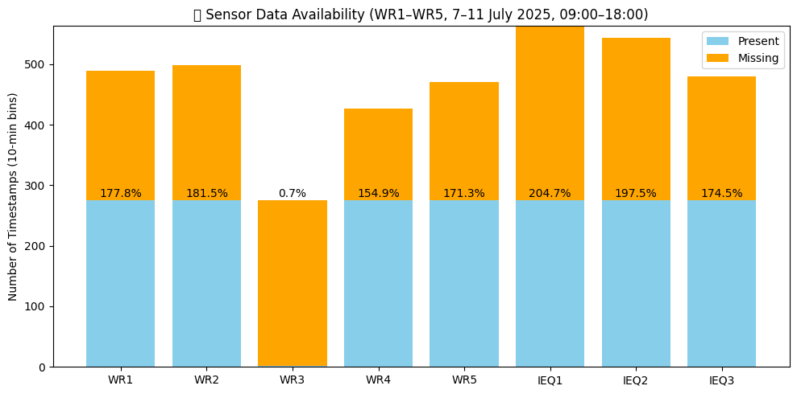
3. CASE STUDY
Key Data and Modeling Considerations
Before using the dataset for occupancy estimation, potential data quality issues should be accounted for:
Temporal gaps in sensor data Some sensors have missing periods, sometimes up to 30–40 minutes.
Irregular sampling frequency Data were collected every 10 minutes up to 2025-10-08, then every 1 minute after that.
Missing-value handling / interpolation risk Short gaps may be handled with time-aware interpolation, but long gaps should be flagged or excluded.
Timestamp alignment and sensor merging Different sensors may not log at the exact same time, so merging requires nearest-time or resampling logic.
Class imbalance in occupancy labels Occupancy examples are not evenly distributed across all possible room counts, so the model is more reliable for common occupancy levels than rare ones.

